Slide 1




BLOOD BANK MANAGEMENT SYSTEM
Matrix

Slide 2

TEAM AND ROLES:
01
02
Vyshnavi
Sriram Thota
03
04
Abhay
Abhinay
Matrix
05
Vineela
Team Leader-Scrum Master,Dev team,QA team
Dev Team Member
BA team member
06
Hajira
QA team member
BA team member
BA team member

Slide 3
INTRODUCTION:
Matrix
About our project:
Our Project is Blood Bank Management system , acts as a owner interface.
It takes the details of persons who are interested to donate the blood and the details are recorded at its end.
It consist of eligibility criteria, where it checks the eligibility of persons to donate the blood.
Based on the eligibility only ,it accepts the quantity of blood to be taken.
It is also helpful for the future use to get the details of blood group and total amount of quantity .
Owner login to fetch the details.

Slide 4
KEY TAKEAWAYS OF PROJECT:
Matrix
Effectively manage blood camps.
Ability to manage the information of its blood donor.
Alerts for blood requirement from registered donors.
List the availability of blood at any given time.
Support fast searching to find match blood bags for the right person.

Slide 5
USER STORIES:
Matrix
The user need to apply in order to donate the blood with some required conditions .
In order to donate blood the Company/Organization should accept the details and store in the database.
If the eligibility conditions are not satisfied by the user the details of the user are deleted from the database.
To check the details of the donor the owner should have own id and password .

Slide 6
USER TASKS:
1.checking of eligibilty (if age>=18 and age<=65 ,haemoglobin level>=12.5) 2.recording details of donor 3.owner login(name,pwd)==>if login successfully fetch the details of person based on particular blood grp(for future) 4.details of blood group,quantity (appending the quantity every time) 5.number of registrations per day
Matrix

Slide 7
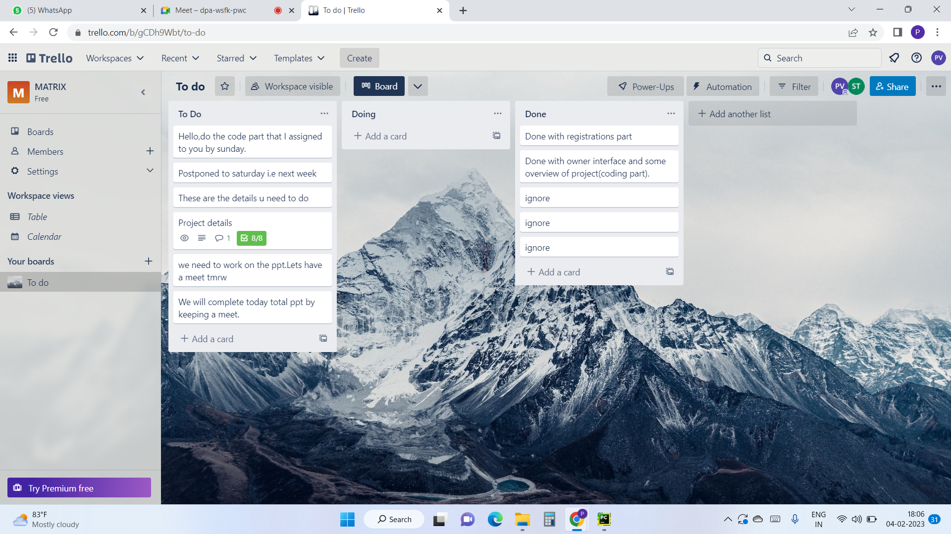
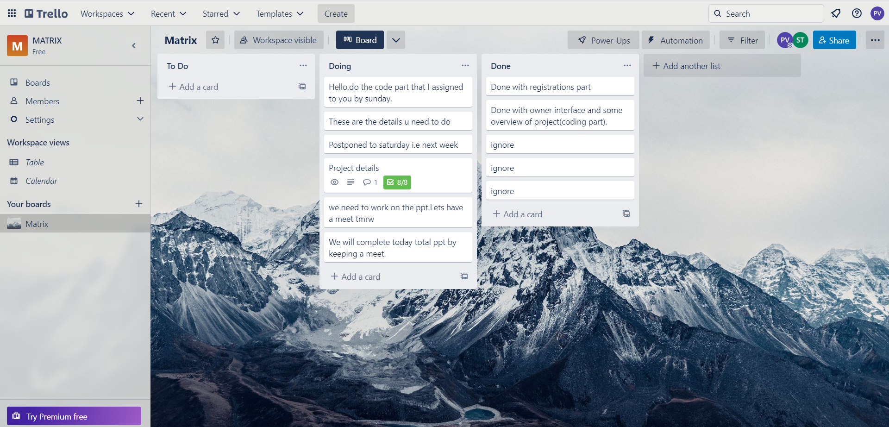
Trello(Scrum Master)
Matrix

Slide 8
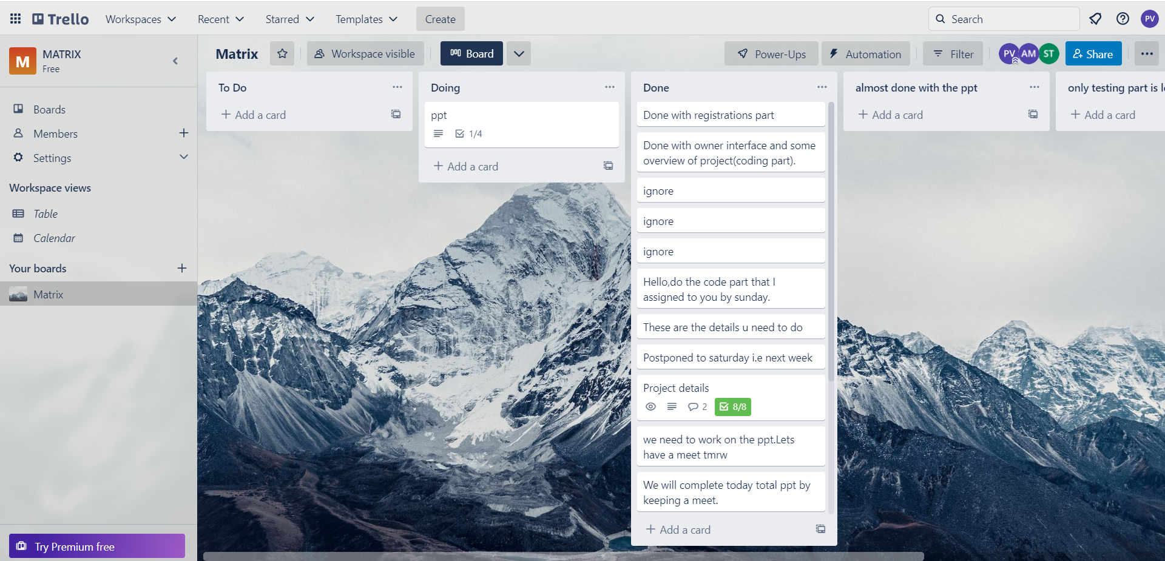
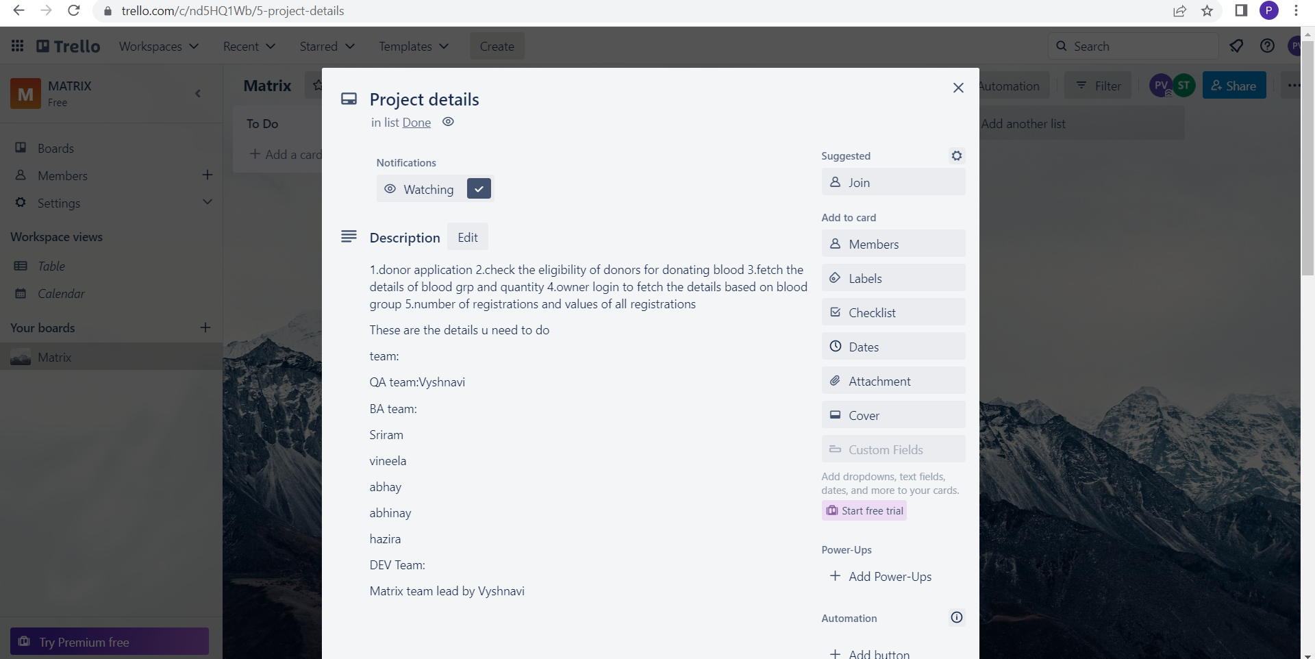
Matrix

Slide 9
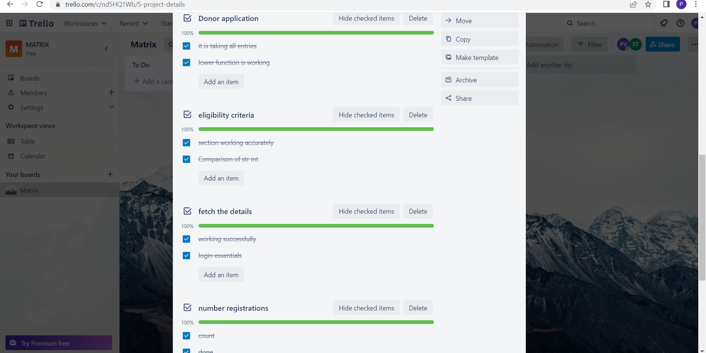
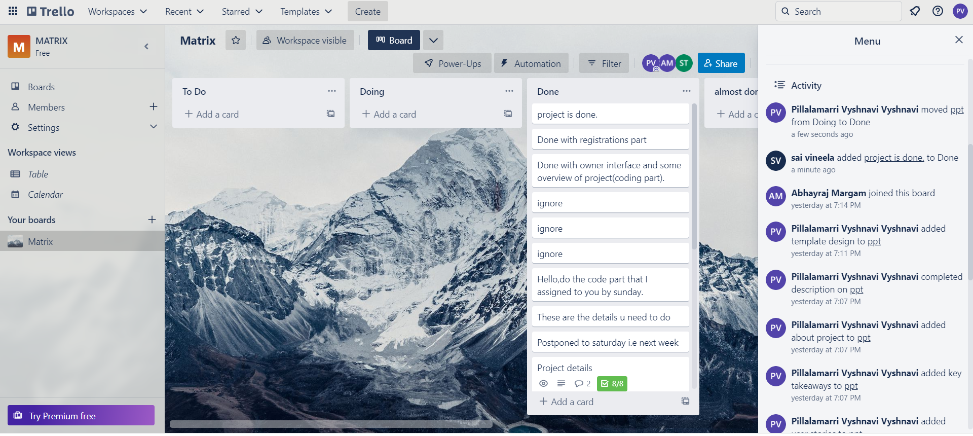
Matrix

Slide 10


IMPLEMENTATION:
Matrix
Dictionary-To store the attributes
Used SQLITE3 to implement the database concepts.
Packages-organize the data into one pack.
Exceptional Handling-To handle the Exceptions and raise the Exception if condition doesn’t meet.
Functions-To call and use it where it’s function need to be defined.
Conditional Statements-Used to meet some particular constraints.
Looping Statements-to traverse the elements .

Slide 11
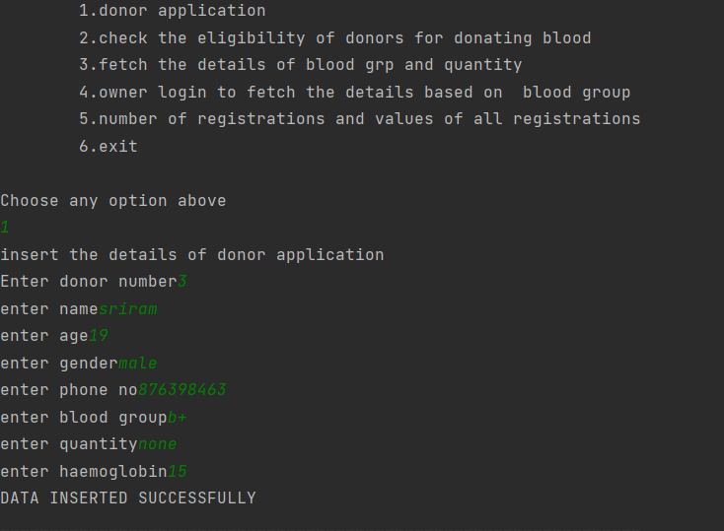
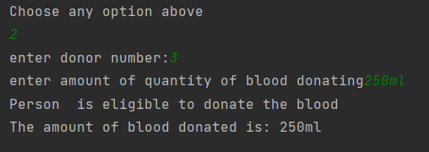
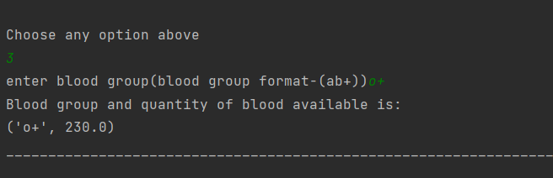
TESTING:
Matrix

Slide 12
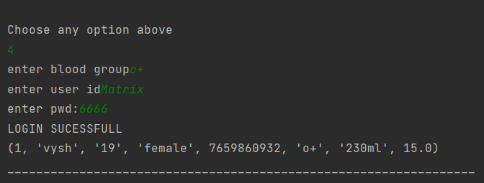
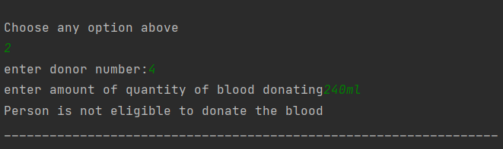
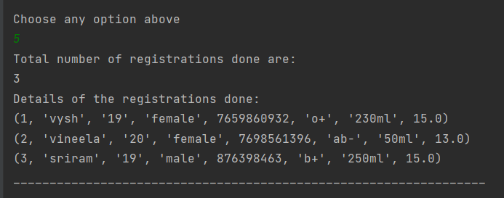
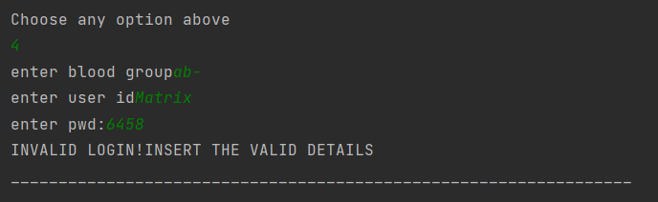
Matrix

Slide 13

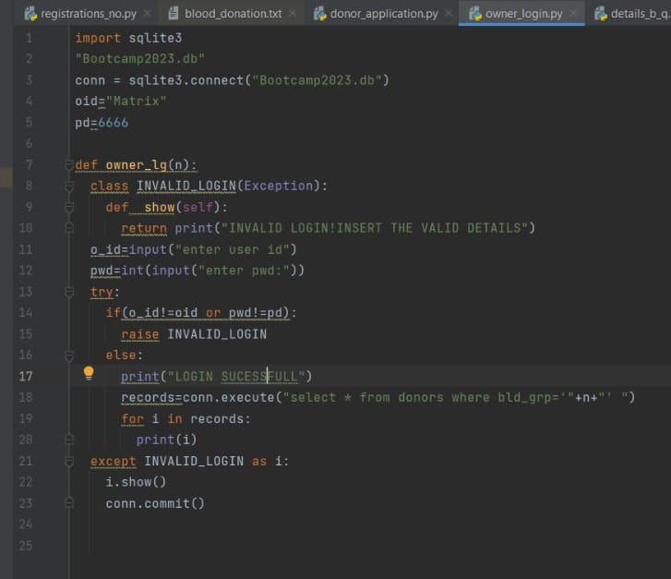
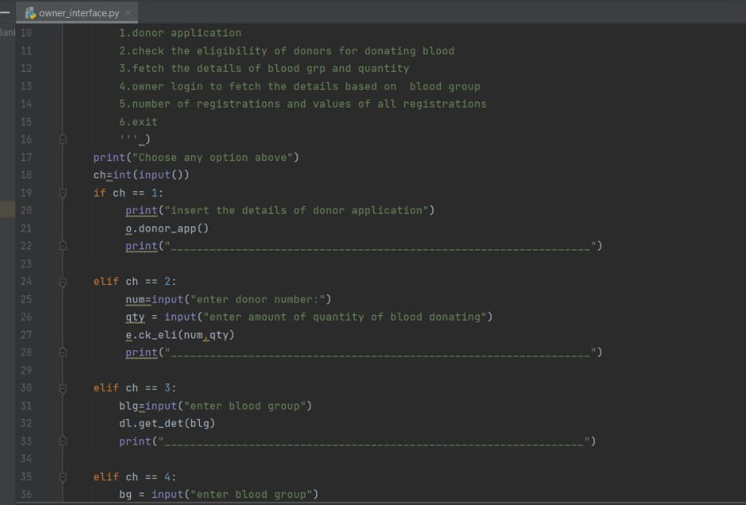
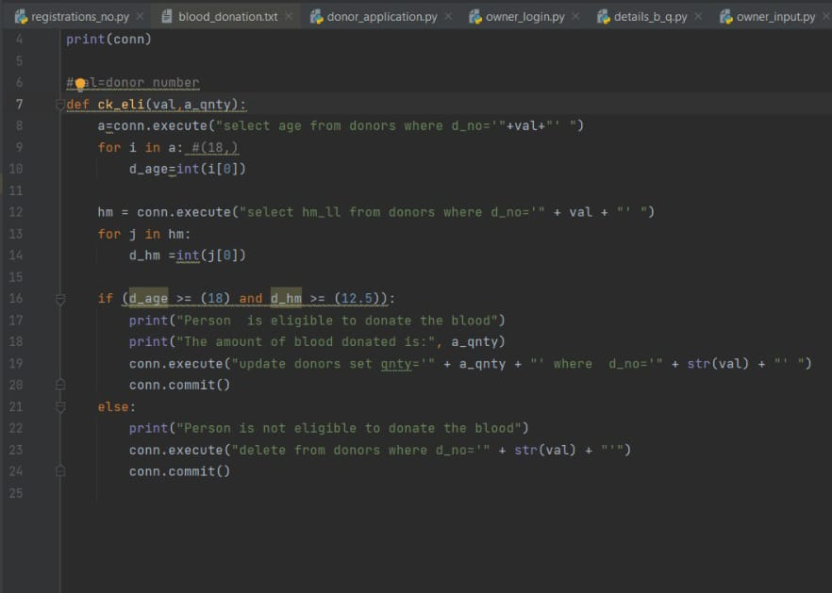
Matrix
PROJECT DEMO:
Owner login
Owner Interface
Blood Donation

Slide 14
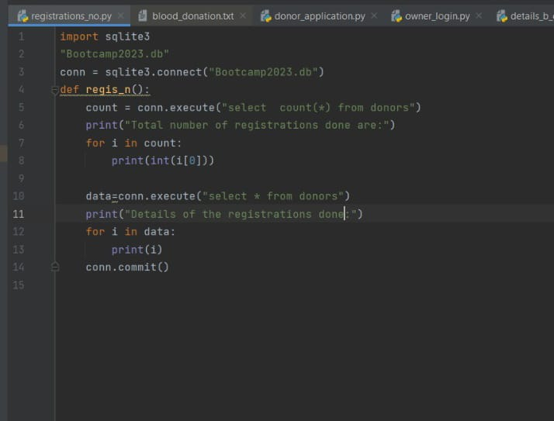
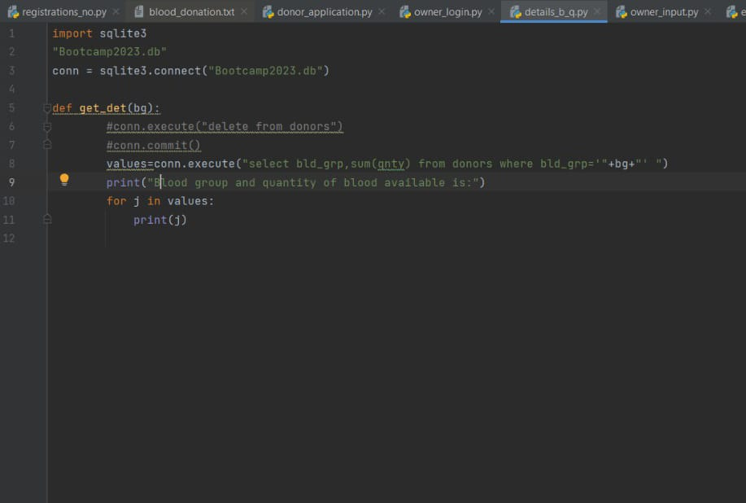
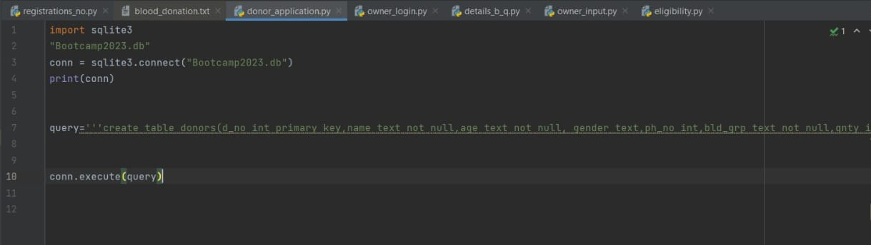
Matrix
Available Details
Registrations
Donor Application

Slide 15
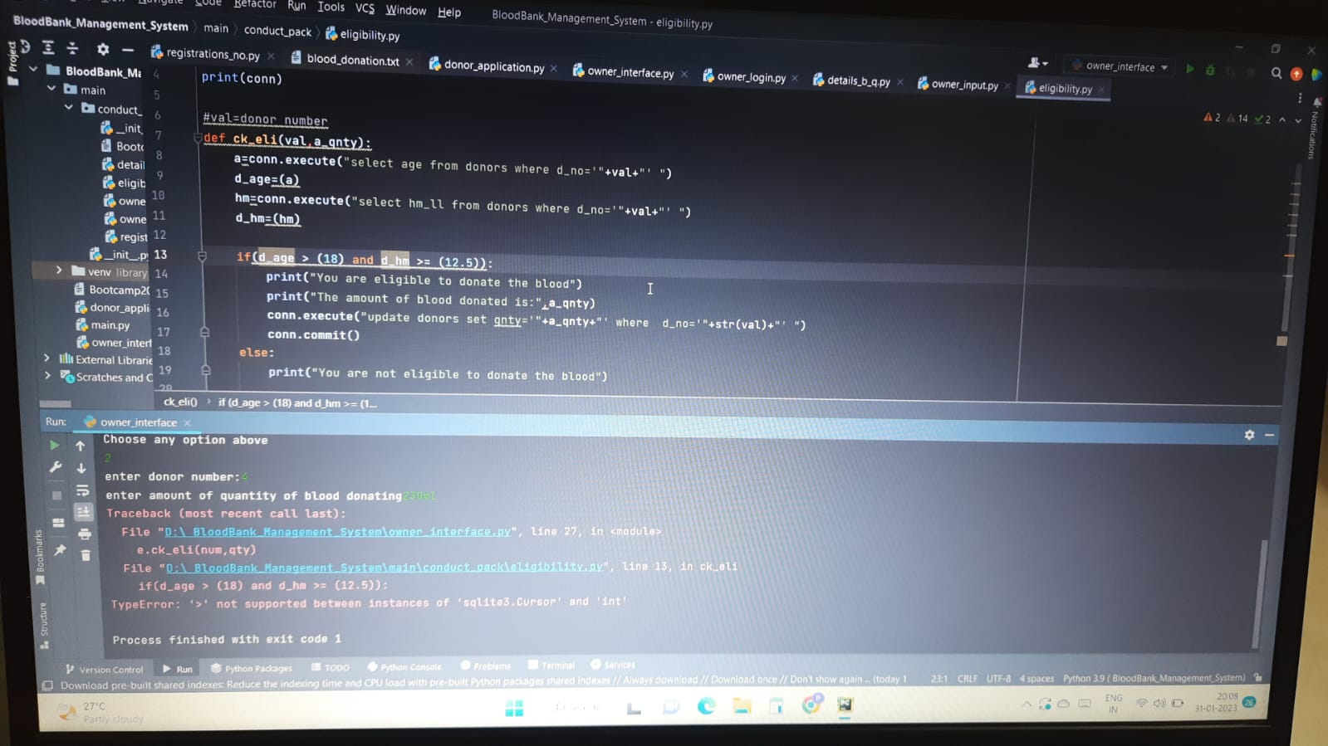
RETROSPECTIVE MEET:
Matrix
Comparison of str and int in the criteria of eligibility is a bit became problematic.
In future , we can link the various hospital details to develop the model.
Databases link up and packages usage is a easy thing.

Slide 16
THANK YOU ☺
Matrix

